Slide 1
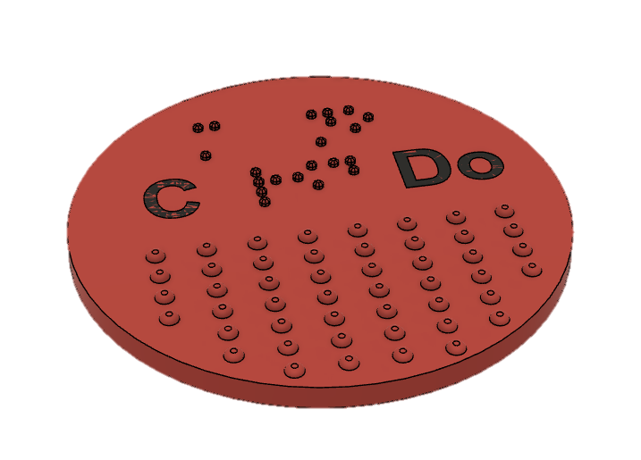
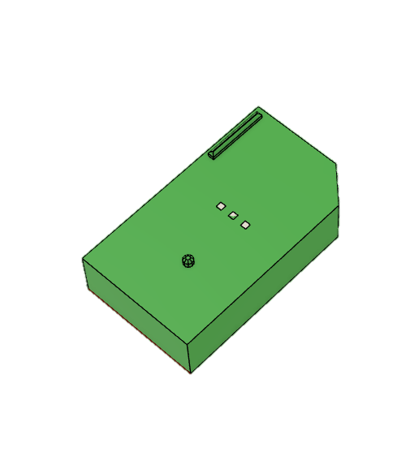
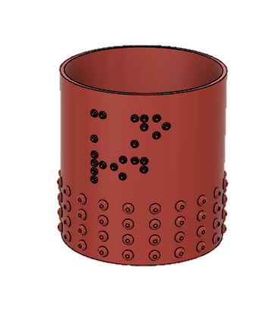
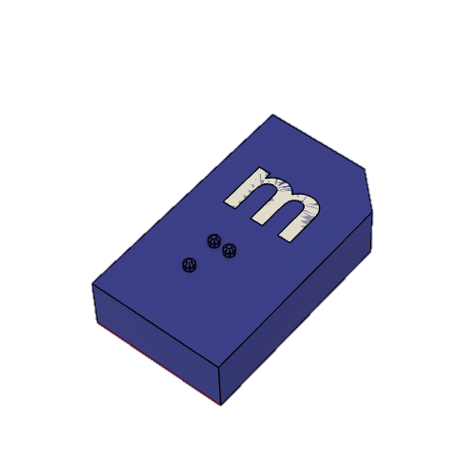
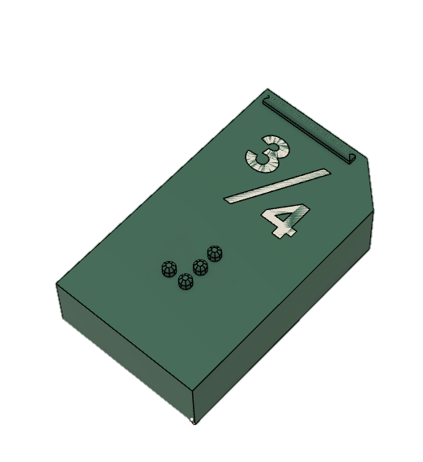
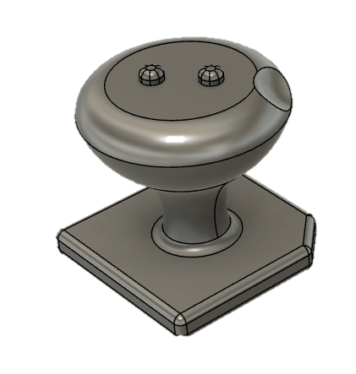
3D Printing at Synscenter Refsnæs Liselotte Kürstein Andersen Graphic Designer Material Production
The national special educational resource and knowledge center for children and young people with visual impairment, including blindness

Slide 2
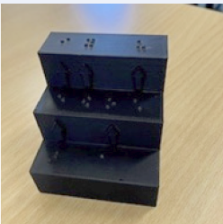
Vokal Stairs
Wish from a Teacher
One of my first 3D projects
What does the letter sound like and what letter to write
Examples:
The Danish word for horse = hest - e sounds like an æ.
The Danish Word for happiness = lykke - y sounds like an ø.
Find the letter you think it is, go up the stairs and you will find the right letter write
My own design
Notes:
Find the letter æ go up the staris and you can se that you need to write the letter e.

Slide 3
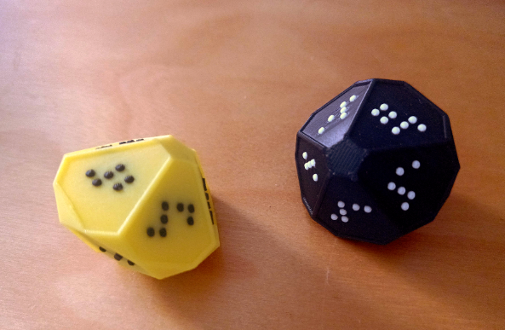
10-sided dice
A wish from a student
Originally produced for a board game
Tested by my college with blindness
Several test models
Countable dots
8 dot
6 dot
To light – added more filling
Math games – Add, multiply or subtract
A visual consultant Lone Ibsen at Refsnæs, recommended the dice for math games and now we print them all the time.
Color
black/white
yellow/black
My own design
8 x 3 = 24
10 + 5 = 15
5 - 2 = 3
Notes:
Tyde = disifer
which way the piece should face
A visual consultant Lone Ibsen at Refsnæs, recommended the dice for math games and now we print them all the time.
Multiply, subtract or add the numbers of a throw of two dices and se who gets the most points in five or ten throws.
Color: visually impaired who needs to learn braille

Slide 4
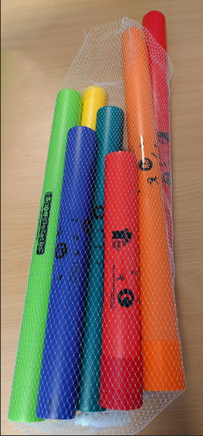
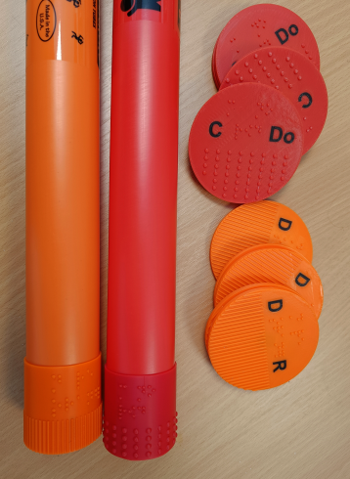
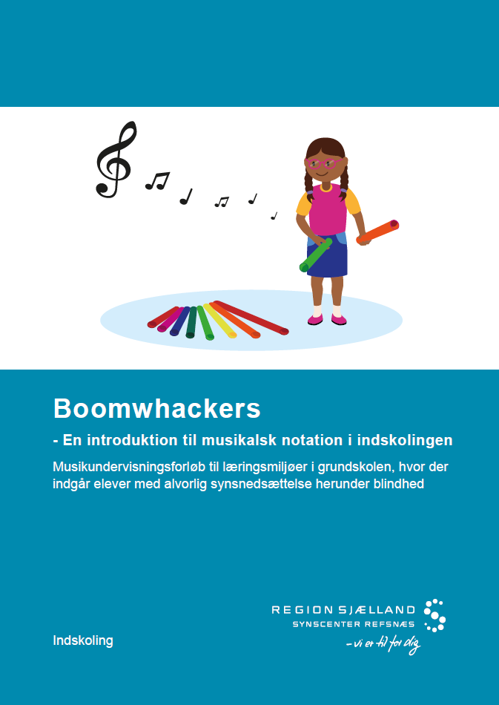
Music project
Boomwhackers
10 publications on teaching music for pupils with visually impairment including blindness
One of them is “Boomwhackers”
3D prints with braille and tactile patterns for the tubes
Magnetic pieces for magnetic bords used instead of musical notation
My own design
Notes:
with similar patternes and braille

Slide 5
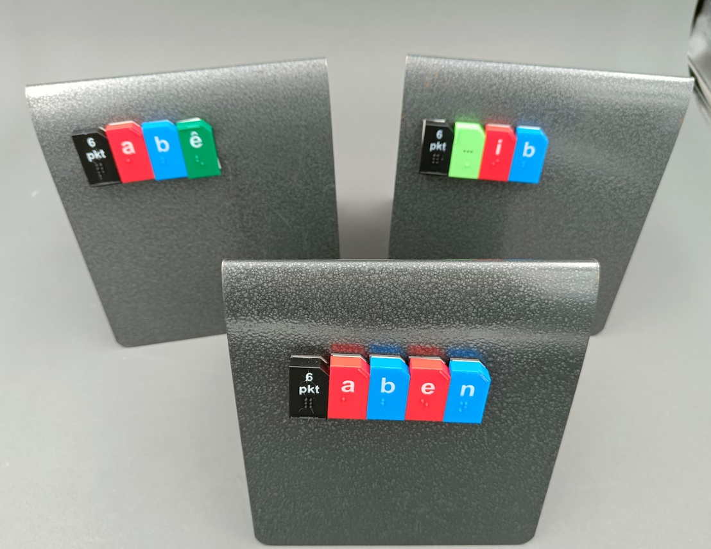
Magnetic alphabetic braille bricks
for teaching braille
The magnetic bricks are a part of an Inclusion project paid by the Ministry of Education
Purpose to make inclusive braille teaching material in Danish for pupils in the 0.-3. grade.
Corporation between:
Synscenter Refsnæs: Working group
Sensus (accessibility experts) is robe holder for the project
The Vocational College - quality assurance
Test groups of students and teachers
Inspiration:
Inspired by the magnetic alphabetic bricks for sighted children
Can be used on Magnetic bord og put on the fridge at home
You can play games with the brics such as fish (cardgame)
My own design
Notes:
0th grade – 0. klasse

Slide 6
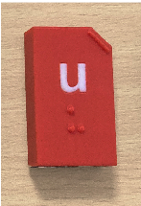
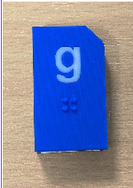
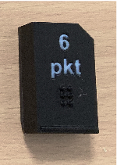
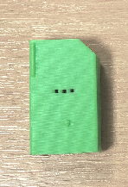
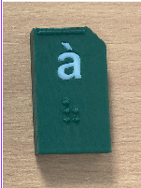
Magnetic alphabetic braille bricks
for teaching braille
Overview of the bricks
They are in 6 dot and with visual text also
The top right corner Is cut of to orient the brick
The braille is in natural size
How to distinguish the bricks
Vocals are red and with a marking at the top left corner
Consonants are blue without marking
Contractions are dark green with a marking at the top
Basic character is black with a marking at the bottom
The sign for capital letter with a marking at the top left .
Notes:
Contrary = modsætning
are in doubt = er i tvivl
Skelne = distinguish

Slide 7
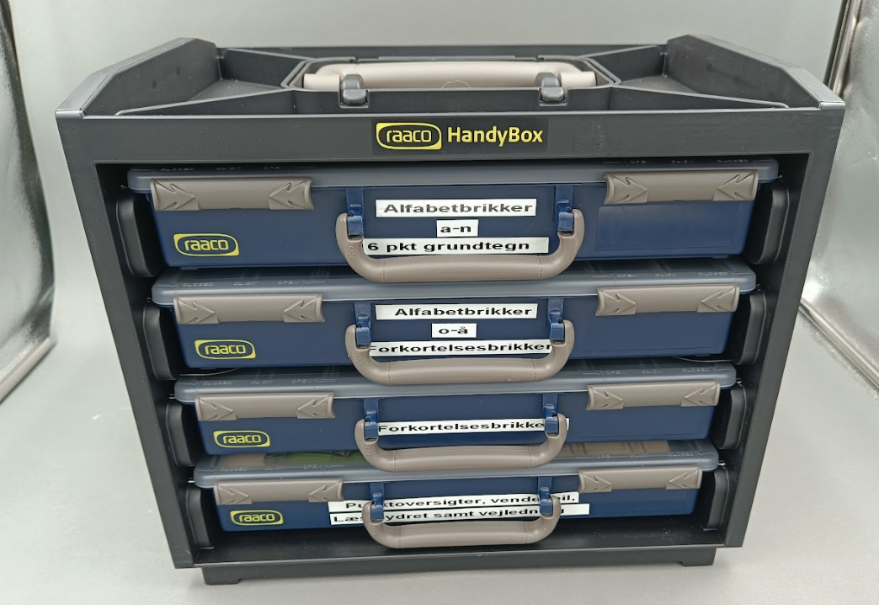
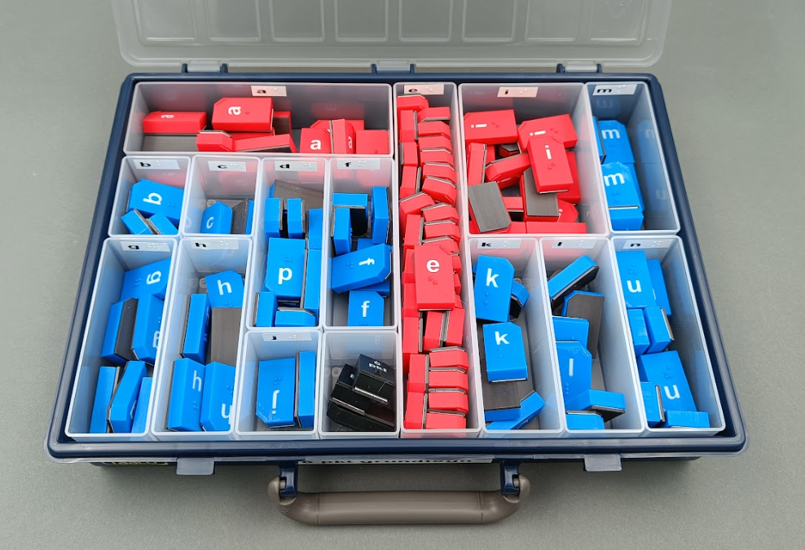
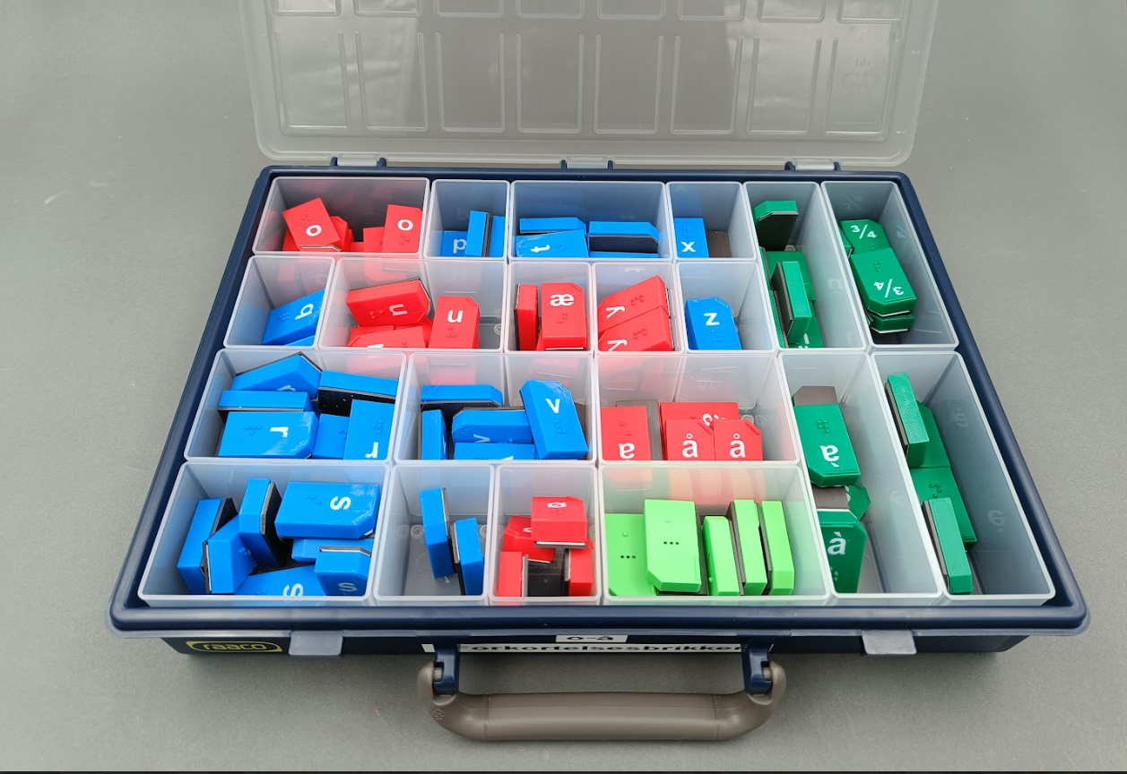
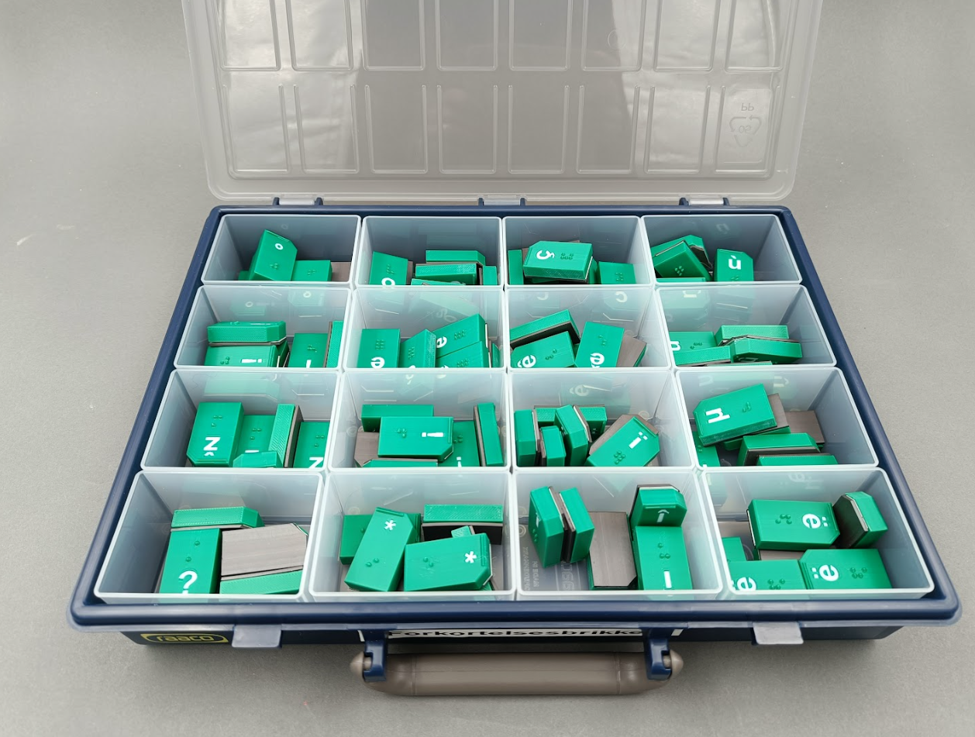
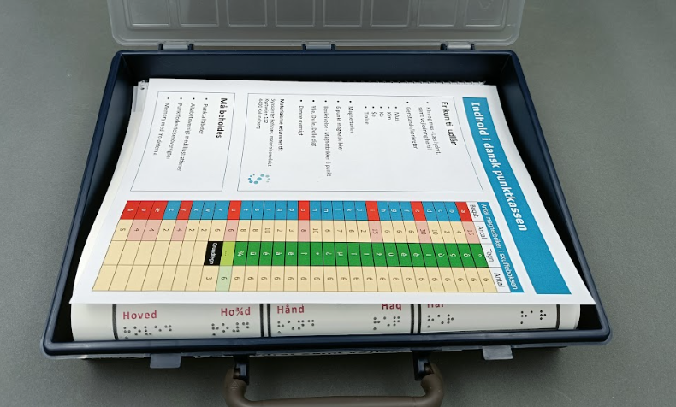
Magnetic alphabetic braille bricks
for teaching braille
They come in a sorting box system with 4 drawers
The drawers are divided into small rooms for each letter
Three of them contains the magnetic braille bricks
The number of each brick has been decided from a frequency overview
The last one is for all the paper materials
Overview of the contractions
The Braille alphabet
Explanation of design of the bricks
An easy reading book with both contracted braille and uncontracted braille
Memory with both contracted and uncontracted braille
QR-codes for 3 learning video on how to read braille – decoding technique, overview of the book and techniques for changing lines.
A poem with both contracted braille and full braille
A publication abort how to include a pupil in the class in primary school and teach them braille.
Notes:
For small children and children with disabilities

Slide 8
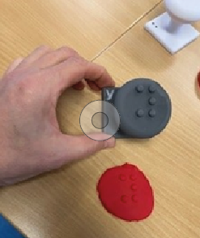
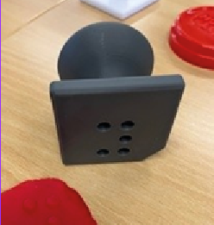
Stamps with Braille
for modeling wax
Inspired by thingiverse.com
Designed over own model
Visual text added
The bottom made rectangular instead of round and with the to left corner cut of on the left side
A more rounded top to make it more comfetable
6 dot Danish alfabet
8 dot Danish alfabet
8 dot Math
Created by my college Charlotte
Notes:
For small children and children with disabilities

Slide 9
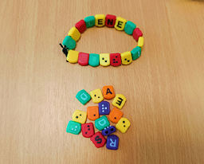
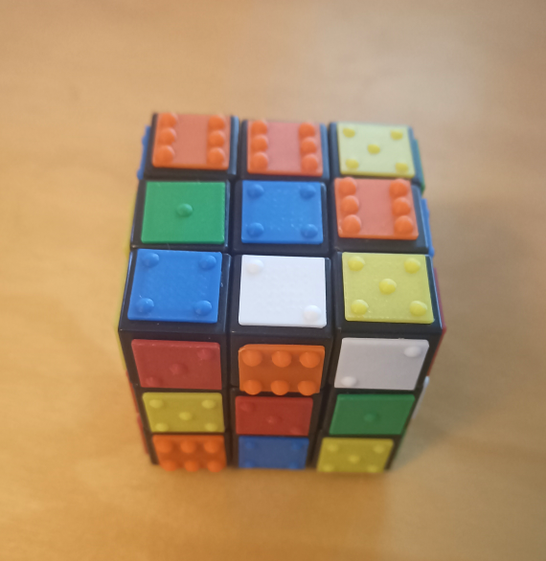
Pearls for Bracelets
with braille and visual text
Inspired by Norway
Made our own model with small changes and in the Danish alphabet
For small children who are to become braille readers
Rubik's cube
Tactile marked pieces to glue on a Rubik’s cube, to make it tactile for people with blindness
Pearls and Rubrik’s cube are both created by my college Charlotte .
Notes:
For small children and children with disabilities

Slide 10
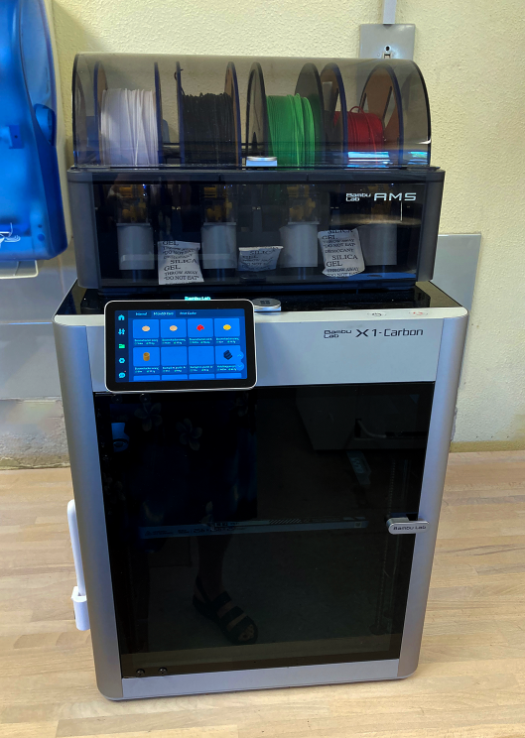
3D production at Synscenter Refsnæs
Material Production
We have two 3D Multicolour 3D Printers – Bambu Lab X1 Carbon with AMS
The AMS makes it possible to print with 4 different colours at a time
For drawing – Fusion 360
For slicing - Bambu Studio
Notes:
We have developed a new method ...
Me and my colleage Bjarne

